Slide 1
IEEE Internal Projects Competition
Week 1: Competition Overview

Slide 2
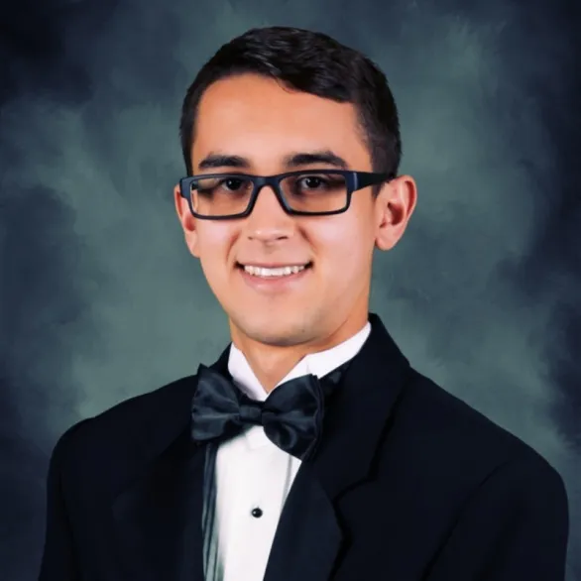
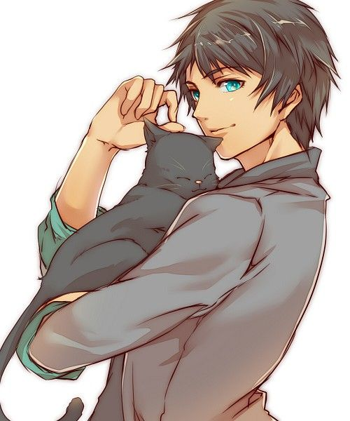
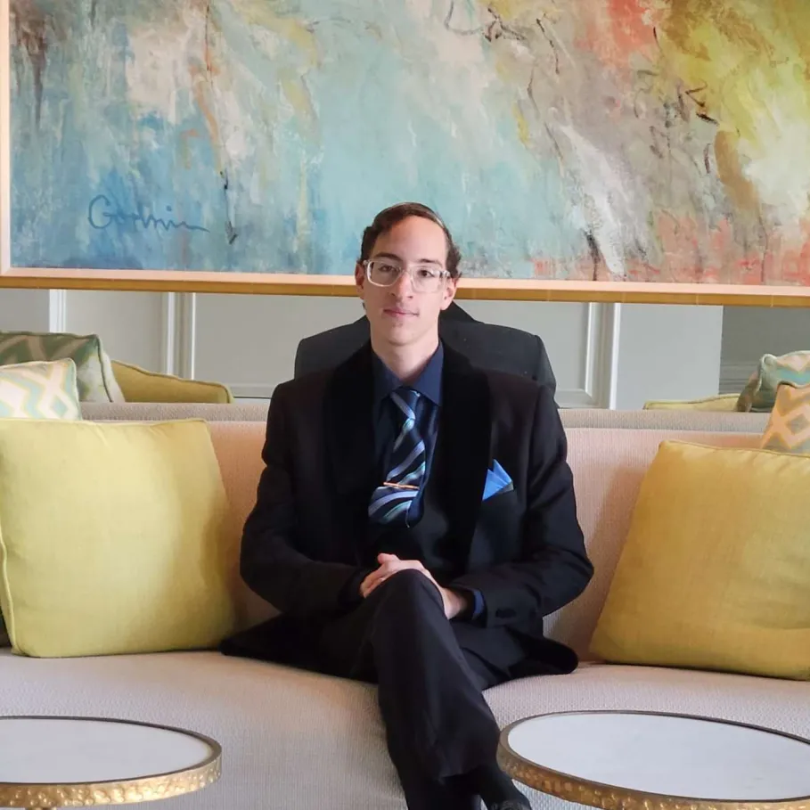
Meet the Team
Matias Guillen
Erik Siegman
Yousef Awad
Project Chair
Sophomore - Electrical Engineering
Internal Project Competition - Lead
Contact: vector8925
Project Committee
Sophomore - Computer Engineering
Internal Project Competition - Sub-Lead
Contact: eriks0527
Project Committee
Sophomore - Computer Engineering
Internal Project Competition - Sub-Lead
Contact: quil180

Slide 3
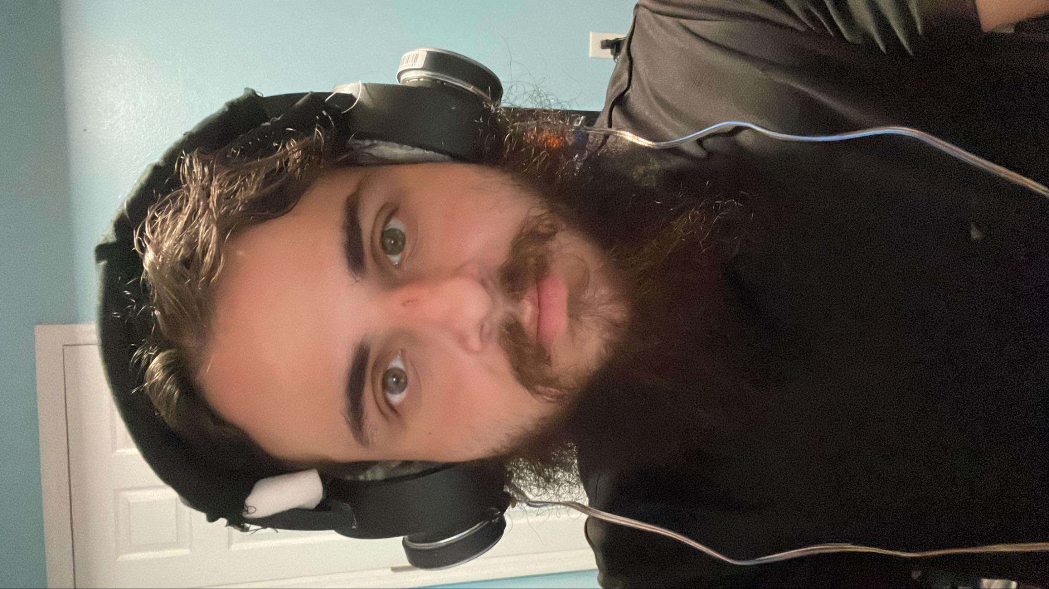
Meet the Team
Tino Hernandez
Project Committee
Sophomore - EE/CS/CPE/Delusion
Internal Project Competition - Sub-Lead
Contact: vjmuzik

Slide 4
Overview
Over the next 2 semesters, work on a group project of your choice.
There will be recurring meetings throughout the semester to meet with groupmates and work on the project, as well as to teach core electronics skills to beginners.
Funding will be provided ($25 Beginner/$50 Advanced) by IEEE for each project.
At the end of the 2 semesters, there will be a project showcase.

Slide 5
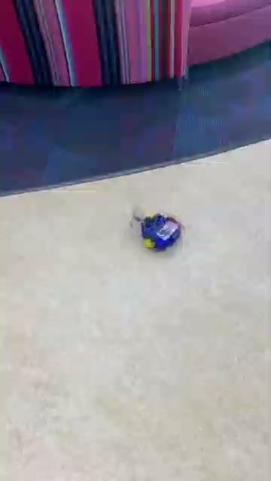
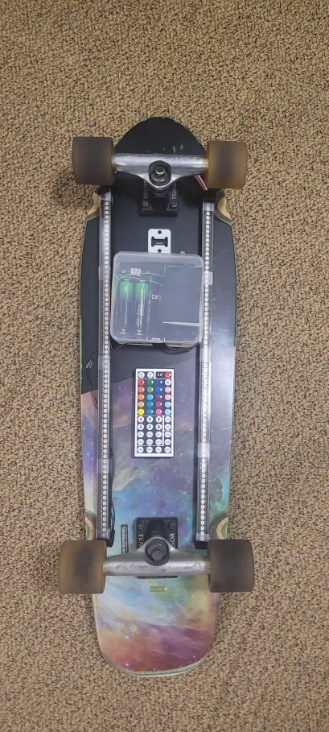

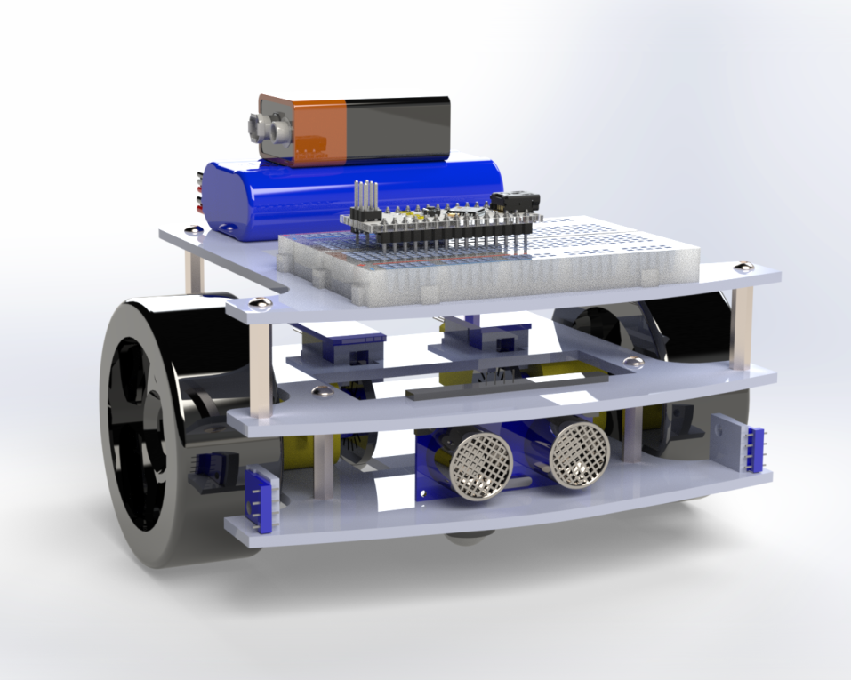
What you can make? - Last years projects
Micromouse
LED Skateboard

Slide 6
Competition Tracks
Beginner:
Who it’s for: New members looking for a guided introduction to the electrical engineering profession
Guidance in selecting a project, writing a BOM, prototyping, and reaching a completed design.
Advanced:
Who it’s for: Members with prior electronics experience looking to receive funding and support for their projects
Technical assistance from project leads
Opportunity for more complex project
Notes:
Expand on which path is best for you? Whether beginner or advanced path.

Slide 7



What you can get it out of this experience?
Awards
For fun!!
Great resume builder!
Group Collaboration
Become a project lead!

Slide 8
Timeline and Important Dates
Weekly Meetings - Estimated Timeline (Starting September 16th)
Week 1 | Week 2 | Week 3 | Week 4 | Week 5
Introduction | Microcontrollers | Fusion 360/Solidworks | KiCAD | Soldering/Prototyping

Slide 9
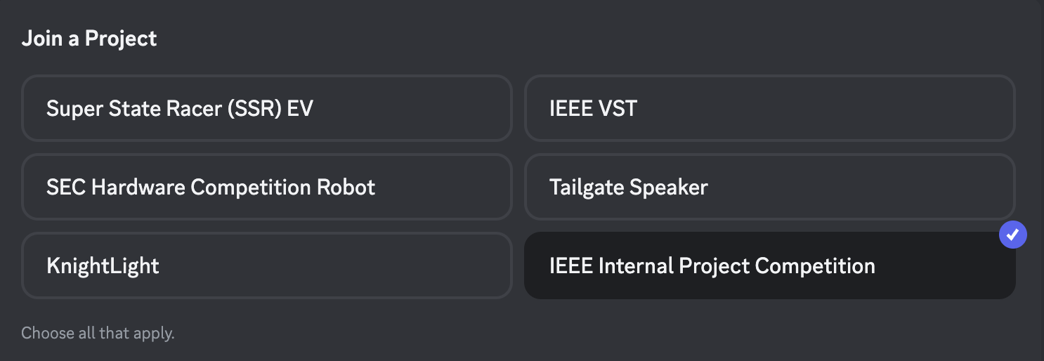
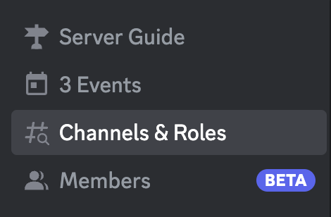
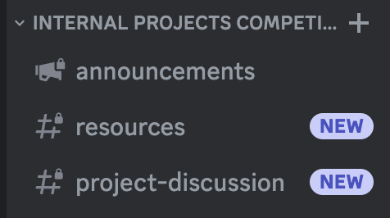
How to join the Discord thread
From IEEE UCF server:
Future communication about meetings, deadlines, and general project discussions will be through these channels

Slide 10
Project Ideas
Beginner Projects:
10 Beginner Projects
Air Quality Monitor
Alarm Clock
Nerf Turret
Audio Visualizer
Visitor Counter
Temperature-Controlled Fan
Solar Tracker
Heartrate Monitor
Plant Watering System
Intermediate/Advanced Projects
Sound Reactive Bluetooth Speaker
Programmable Macro Pad
Guitar Pedal
DIY Airtag/GPS Tracker
Smart Mirror
Live Weather Station
ESP32 Text to Speech Webserver
Productivity Logger
Smartwatch

Slide 11
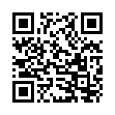
Signup Form

Slide 12
Additional Information
Projects can continue into spring semester especially advanced ones.
Project teams can meet outside of scheduled meeting times.
You can go over budget but it will be out of pocket.
Highly recommended to be in a group.
No limit to group size only limit is budget.

Slide 13
Next Week’s Session:
Finalizing teams
Brainstorming project ideas
Microcontroller workshop
Next session will be on Monday, September 23

